Slide 1
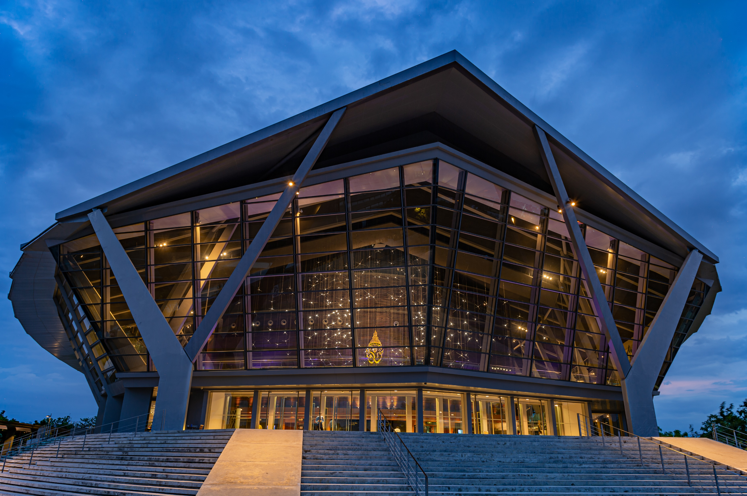

Slide 2
QUICK FACT
Founded
1888
(Thailand’s first hospital: Siriraj Hospital)
Teaching languages
Thai & English
Status
Public and multi-disciplinary university
University hospitals
Siriraj Hospital
Siriraj Piyamaharajkarun Hospital
Golden Jubilee Medical Center
Ramathibodi Hospital
Chakri Narubodindra Hospital
Dental Hospital
Maha Chakri Sirindhorn Dental Hospital
Hospital for Tropical Diseases
Mahidol Nakhonsawan Medical Center
Pasupalun Livestock & Wildlife Hospital
Prasu Arthorn Veterinary Teaching Hospital
Inner Bangkok campuses
Phaya Thai Campus
Bangkok Noi Campus
Outskirts and regional campuses
Salaya Campus
Kanchanaburi Campus
Nakhon Sawan Campus
Amnat Charoen Campus

Slide 3
QUICK FACT
Student enrollment
Staff
Academic staff
Full-time academic staff
Teaching staff with doctoral degrees
International environment:
Foreign academic staff
Foreign support staff
Foreign students (2017-2021)
Degrees awarded:
Bachelor, Master, Doctorate,
Double, Joint & Cotutelle programs
SPOCs
MOOCs
32,675
37,471
4,015
3,985
3,550
142
133
1,500
380
77
Academic calendar
Semester
1st Semester:
Mid of August – mid of December
2nd Semester:
Mid of January – end of May
Trimester (Mahidol University International College)
1st trimester:
Beginning of September – beginning of December
2nd trimester:
Beginning of January – beginning of April
3rd trimester:
End of April – end of July

Slide 4
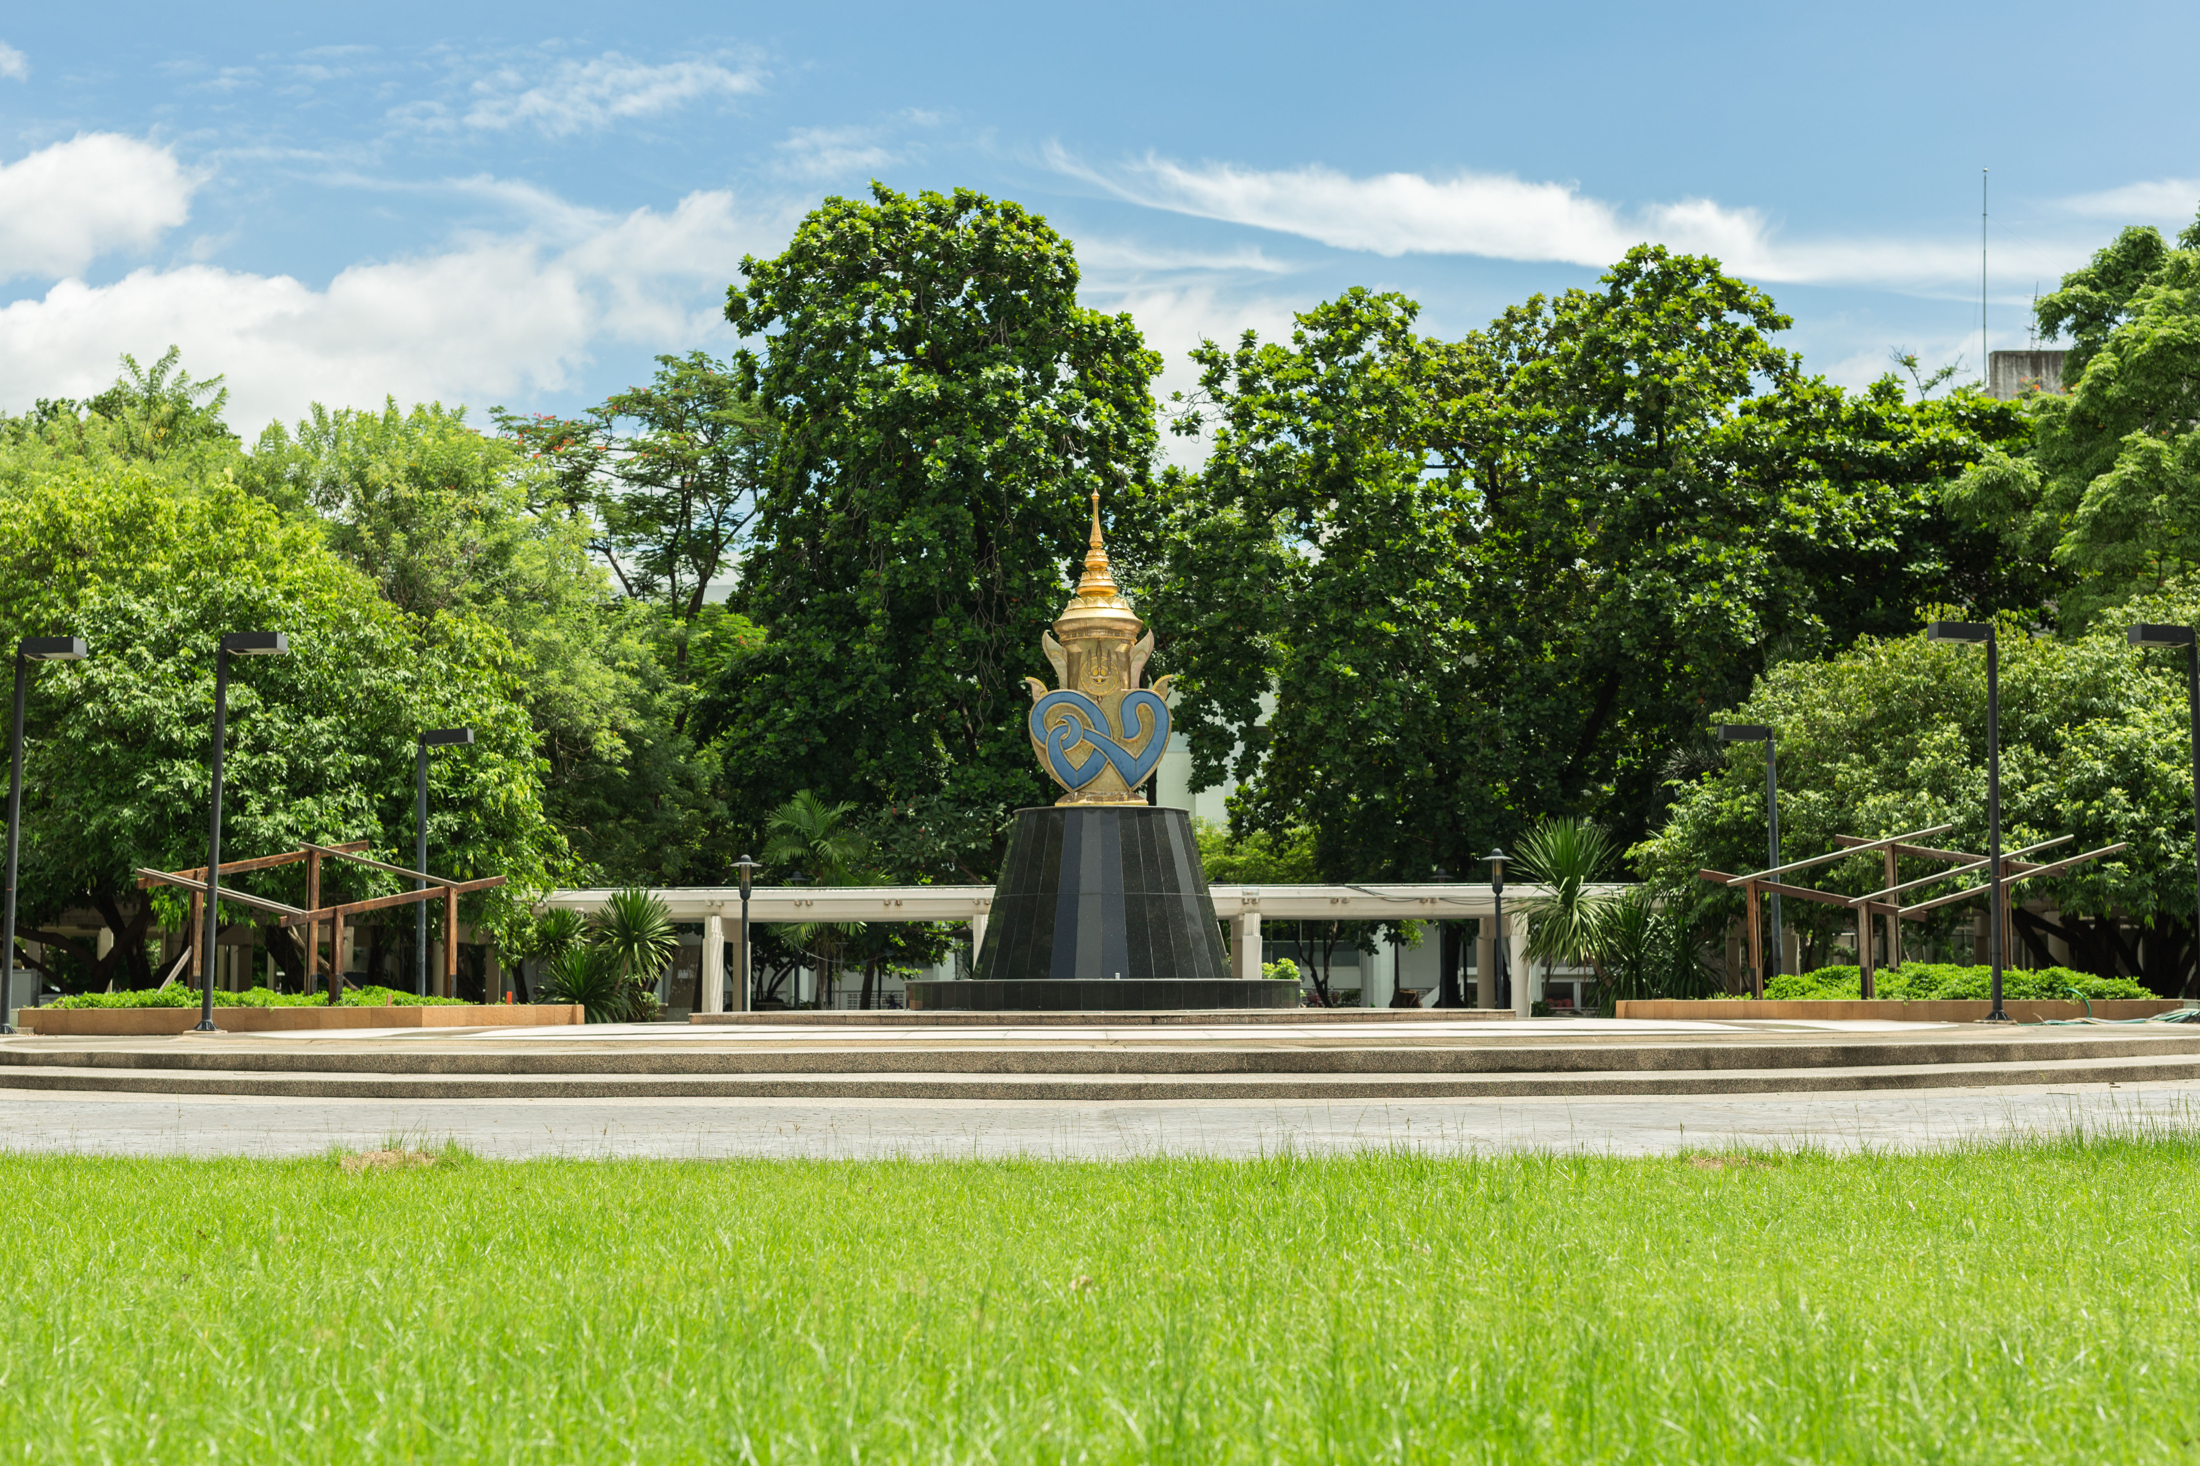
Comprehensive Education
Health Sciences
Sciences and Technology
Arts, Humanities, Social Sciences and Business
17 Faculties
5 Colleges
Faculty of Dentistry
Faculty of Engineering
Faculty of Environment and Resources Studies
Faculty of Graduate Studies
Faculty of Information and Communication Technology
Faculty of Liberal Arts
Faculty of Medical Technology
Faculty of Medicine Ramathibodi Hospital
Faculty of Medicine Siriraj Hospital
Faculty of Nursing
Faculty of Pharmacy
Faculty of Physical Therapy
Faculty of Public Health
Faculty of Science
Faculty of Social Sciences and Humanities
Faculty of Tropical Medicine
Faculty of Veterinary Sciences
College of Management
College of Music
College of Sports Science and Technology
College of Religious Studies
Mahidol University International College (MUIC)
8 Institutes
ASEAN Institute for Health Development
Institute of Human Rights and Peace Studies
Institute for Innovative Learning
Institute of Molecular Biosciences
Institute of Nutrition
Institute for Population and Social Research
National Institute for Child and Family Development
Research Institute for Languages and Cultures of Asia
17 FACULTIES
5 COLLEGES
8 INSTITUTES
1 Demonstration
School
1 Demonstration School
Mahidol University International Demonstration School

Slide 5
Double Degree Programs
B.Sc. in Bioresources and Environmental Biology with State University of New York, USA
B.Sc. in Bioinnovation / B.Sc. in Biomedical Science with University of Sussex, UK
B.Sc. in Actuarial Science / B.Sc. in Industrial Mathematics with Curtin University, Australia
B.Sc./ Ph.D. in Materials Science and Nano Engineering with University Technology Sydney, Australia
M.Sc. in Implant Dentistry with International Medical College, MIB GmBh, Munster, Germany
M.Sc. in Biotechnology / MA in Applied Linguistics with Osaka University, Japan
M.Sc. in Plant Science / Ph.D. in Biotechnology with Chiba University, Japan
M.Eng. in Environmental and Water Resource Engineering with Kyoto University, Japan
MA in Human Rights and Democratization with Ateneo de Manila University, Philippines, Universitas Gadjah Madah, Indonesia, Purbanchal University, Nepal, and University of Colombo, Sri Lanka
MM in Management with University of Toulouse, France
M.Sc. in Computer Science with University College London, UK
Bachelor's degree
Master's degree
Ph.D. in Biotechnology / Ph.D. in Material Science with Niigata University, Japan
Ph.D. in Prosthetics and Orthotics with Nigata University of Health and Welfare, Japan
Ph.D. in Sports Science with Liverpool John Moores University, UK
Doctor's degree
Joint Degree Programs
M.Sc. In Clinical Epidemiology with Chulalongkorn University and Khon Kaen University, Thailand
Ph.D. in Biomedical Sciences with Glasgow University, UK
Ph.D. in Medical Sciences with Tokyo Medical and Dental University, Japan

Slide 6
NO. 1
IN THAILAND
BY SUBJECT
Performing Arts Top 50
Pharmacy & Pharmacology Top 100
Life Sciences & Medicine Top 101-150
Anatomy & Physiology Top 101-200
Nursing Top 101-200
Medicine Top 101-200

Slide 7
Mahidol University
has been globally recognized
By international accreditation agencies.

Slide 8
12 Cluster of Excellence
Medicine
Immunology
Biological Sciences
Pharmacology and Toxicology
Biology and Biochemistry
Public Health, Environmental Health
and Occupational Health
v
Biotechnology and
Applied Microbiology
v
Clinical Medicine
v
v
Infectious Diseases
Pharmacy and Pharmacology
v
v
Microbiology
Molecular Biology and Genetics

Slide 9
10 WHO Collaborating Centers
Traditional Medicine,
Faculty of Medicine Siriraj Hospital
Case Management, Training and Research on Malaria,
Faculty of Tropical Medicine
Oral Health Education and Research,
Faculty of Dentistry
Prevention and Control of Poisoning,
Faculty of Medicine Ramathibodi Hospital
Nursing and Midwifery Development,
Ramathibodi School of Nursing
Research in Human Reproduction,
Faculty of Medicine Siriraj Hospital
Nursing and Midwifery Development,
Faculty of Nursing
Antimicrobial Resistance (AMR) Prevention and Containment, Faculty of Medicine Siriraj Hospital
Research in Human Reproduction,
Institute for Population & Social Research
Community Nutrition and Food Safety,
Institute of Nutrition

Slide 10
Joint Units
Research and Training Joint Unit on Carbon Neutrality Campus
Faculty of Environment and Resource Studies – EN in collaboration with
Shanghai Jiao Tong University, China and The Economic and Social Commission for Asia and the Pacific (ESCAP)
Upcoming
19 units
2024
International Public Health Training Center (IPTC)
Faculty of Public Health - PH in collaboration with Taiwan International Healthcare Training Center (TIHTC), Taipei Hospital, Ministry of Health and Welfare, Taiwan R.O.C.
Mahidol – York Interdisciplinary Living Research Excellence Center
Mahidol University Kanchanaburi Campus - KA in collaboration with
University of York, UK
Cooperation toward Multidisciplinary Genomic Epidemiology to training to Protect Thailand from Emerging infectious Diseases in the Age of Big Data
Faculty of Tropical Medicine - TM in collaboration with Big Data Institute, Oxford University, UK
CU-MU Collaborative Research and Training Center in Plant Factory
Faculty of Science – SC in collaboration with Chiba University, Japan
ASEAN Hearing Hub and Communication Sciences Center
Faculty of Medicine Ramathibodi Hospital in collaboration with Macquarie University, Australia
Mahidol - Imperial College London Medical Robotics Research Collaboration
Faculty of Engineering - EG in collaboration with The Hamlyn Centre, Imperial College London, UK
MU – NCKU Joint Research Unit
Faculty of Dentistry - DT in collaboration with National Cheng Kung University, Taiwan R.O.C.
1
Joint Research Center for Healthy Active Lifestyle (CHAL)
College of Sports Science – SS and Technology in collaboration with University of Western Australia, Australia
Liverpool-Mahidol Joint Ageing Laboratory
Faculty of Pharmacy - PY in collaboration with University of Liverpool, UK
Mahidol - UW Malaria Research Unit
Faculty of Tropical Medicine - TM in collaboration with University of Washington in Seattle, USA
Mahidol – AIST Research Unit (MARU)
Faculty of Information and Communication Technology – ICT in collaboration with
The National Advanced Industrial Science and Technology (AIST), Japan
MU – ETH Iodine Research and Training Unit
Institute of Nutrition – NU in collaboration with Swiss Federal Institute of Technology (ETH), Switzerland
Joint Laboratory and Training Unit - Development of Viral Vector Service Unit
Faculty of Medical Technology - MT in collaboration with Institute for Functional Genomics (IGF), France
MU – JHU NCD Research Collaborative Center
Faculty of Nursing – NS in collaboration with John Hopkins University, USA
Research & Innovation Center of Human movement sciences (RICHms)
Faculty of Physical Therapy - PT in collaboration with The University of Texas at Austin, University of Southern California, University of Central Lancashire
Mahidol Migration Center (MMC)
Institute for Population and Social Research – IPSR in collaboration with various universities and organizations
Mahidol – Bremen Medical Informatics Research Unit (MIRU)
Faculty of Information and Communication Technology - ICT, Faculty of Medicine Ramathibodi Hospital - RA, Faculty of Dentistry - DT, Faculty of Tropical Medicine - TM, and Faculty of Veterinary Science – VS
in collaboration with University of Bremen, Germany
Harvard University and Mahidol University Research and Training Unit
Institute of Nutrition - NU in collaboration with Harvard University, USA
Notes:
As of March 2024 – Updated with Owner Project

Slide 11
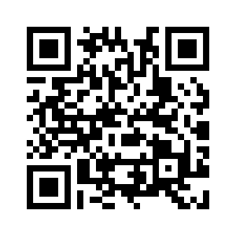
Exchange Programs
Academic Calendar
Nomination and Application deadline
Year 2023/2024
How to apply?
Semester
The following documents need to be submitted to us:
1st Semester:
(Fall Semester)
2nd Semester:
(Spring Semester)
Fall semester
1st Semester: 25 May
A valid passport.
Your TOEFL/IELTS scores, if any. (The minimum acceptable level for admission varies for different subjects, but is normally not less than a TOEFL score of at least 69 for the internet-based test or IELTS 6.0.)
Your academic transcript(s) (e.g. college/university education)
An up-to-date passport photo (in jpg/jpeg format, size 1MB max)
Reference Letter from the Home University
If you apply for postgraduate program, you have to buy health insurance from Faculty of Graduate Studies.
It would take about 2 – 4 weeks for the host faculty to consider your application.
After the acceptance, the coordinator from host faculty will contact you concerning housing reservation.
Mid of
August
Mid of
December
Mid of
January
End of
May
Spring semester
2nd Semester: 25 October
Trimester
Mahidol University International College - MUIC
*Noted - Please apply through the MUIR Officer responsible for each region or the IR Officer for each faculty/college.
1st Semester:
2nd Semester:
3rd Semester:
Beginning of September
Beginning of January
End of April
Nomination and Application deadline
Year 2023/2024
(*Only Mahidol University International College - MUIC)
Beginning of December
Beginning of April
End of July
Nomination deadline:
Inbound Exchange Programs
1st Semester:
2nd Semester:
3rd Semester:
100+ international courses
15 February 2023
to
30 April 2023
1 July 2023
to
30 August 2023
1 October 2023
to
30 November 2023
Varied academic levels:
Diploma, Bachelor,
Master’s, Ph.D. and short-
Course training
For more information and submit the document, please contact: opinter@mahidol.ac.th
Scan the QR code to download the application, please visit: https://op.mahidol.ac.th/ir/mu-application
Application deadline:
Website URL:
https://callforexchange.mahidol.ac.th/inbound
1st Semester:
2nd Semester:
3rd Semester:
30 June 2023
30 September 2023
31 January 2024

Slide 12
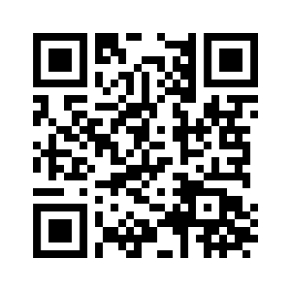
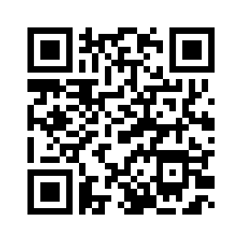
Mobility Programs 2024 for Inbound Students from Partner Universities
Sawasdee Thailand Summer 2024
MUIR Tailor-made Program
Scan QR code
Scan QR code
For more information and apply now via
https://op.mahidol.ac.th/ir/sawasdee2024
For more information and apply now via
https://op.mahidol.ac.th/ir/tailor-made
Contact
Ms. Chonlada Prommachartsuntorn, MUIR Officer
Email: sawasdee.mahidol@gmail.com
Contact
Ms. Lamdoun Pluangklang, MUIR Officer
Email: lamdoun.plg@mahidol.ac.th

Slide 13
Thank you

